Slide 1


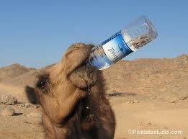


The Revolt of Birsa Munda, the Golden Age
Made By:-
Made by: Aniket Dixit, Ekjot Singh, Mayank Gupta and Sia Panigarhi, students of Class-VIII-A
Group name- The ArchaeologisT.

Slide 2
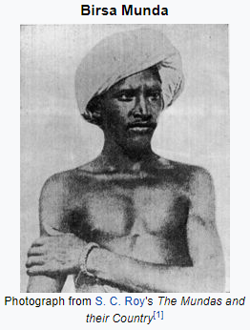
Who was Birsa Munda?
Birsa Munda, born 15 November, 1875, was an Indian Tribal Freedom Fighter, Religious Leader, and Folk Hero who belonged to the Munda Tribe. He spearheaded an Indian Tribal Religious Millenarian that arose in the Tribal Belt of modern-day Bihar and Jharkhand in the late 19th century, during the British Raj, thereby making him an important figure in the history of the Indian Independence Movement. His achievements are even more remarkable for having been accomplished before the age of 25.

Slide 3
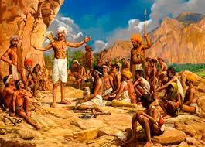
The Munda Rebillion
Munda Rebellion is one of the prominent 19th century tribal rebellions in the subcontinent. Birsa Munda led this movement in the region south of Ranchi in 1899-1900. the ulgulan, meaning 'Great Tumult', sought to establish Munda Raj and independence. The Mundas traditionally enjoyed a preferential rent rate as the khuntkattidar or the original clearer of the forest. But in course of the 19th century they had seen this khuntkatti land system being eroded by the jagirdars and thikadars coming as merchants and moneylenders.

Slide 4
Birsa Munda’s Life
Though he lived a short span of life, Birsa Munda is known to have mobilized the tribal community against the British and had also forced the colonial officials to introduce laws protecting the land rights of the tribal.
Birsa Munda was a young freedom fighter and a tribal leader, whose spirit of activism in the late nineteenth century, is remembered to be a strong mark of protest against British rule in India. Born and raised in the tribal belt around Bihar and Jharkhand, Birsa Munda’s achievements are known to be even more remarkable by virtue of the fact that he came to acquire them before he was 25. In recognition of his impact on the nationals movement, the state of Jharkhand was created on his birth anniversary in 2000.
Born on November 15, 1875, Birsa spent much of his childhood moving from one village to another with his parents. He belonged to the Munda tribe in the Chhotanagpur Plateau area. He received his early education at Salga under the guidance of his teacher Jaipal Nag. On the recommendation of Jaipal Nag, Birsa converted to Christianity in order to join the German Mission school. He, however, opted out of the school after a few years.

